Slide 1
FortofKnowledge – Smart Real-Time Book Platform
FortofKnowledge is a modern book platform designed to provide a secure, fast, and real-time experience. It improves how users search, explore, and purchase books by using modern technologies and efficient system design.

Slide 2
Problem & Solution
In many existing systems, book platforms are slow and do not provide real-time updates. Users face delays while searching for books, placing orders, and tracking them, which leads to a poor user experience.
To solve this, we developed a system that is fast, secure, and easy to use. Our platform ensures smooth performance, better security, and instant updates for users.

Slide 3
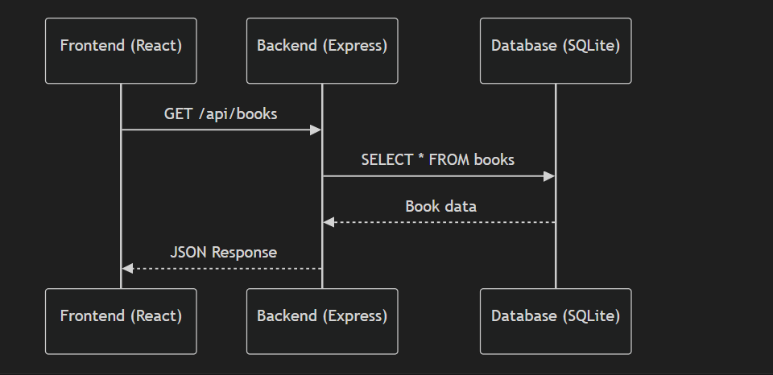
Architecture
Our system follows a client-server architecture. The frontend is built using React to provide a responsive and interactive user interface. The backend is developed using Node.js and Express to handle business logic and APIs. SQLite is used as a lightweight database, and Socket.io enables real-time communication.

Slide 4
Tech Stack & Security
We used modern technologies like React and Tailwind CSS for the frontend, and Node.js with Express for the backend. SQLite is used for database management.
For security, we use BCrypt to hash passwords securely and JWT for authentication. These techniques ensure that user data is protected and only authorized users can access the system.

Slide 5
Performance & Design
To improve performance, we implemented debouncing to reduce unnecessary API calls during search operations. We also use indexing in the database to speed up data retrieval.
We applied design patterns such as the Observer pattern for real-time updates, middleware for secure request handling, and React’s Virtual DOM for efficient UI rendering.

Slide 6
Features & Real-Time
Our platform provides features for both users and admins. Users can log in, search books, add items to cart, and place orders. Admins can manage books, users, and orders through a dashboard.
The key highlight is real-time updates. When a user places an order, stock updates instantly and the admin receives a live notification without refreshing the page.

